Slide 1
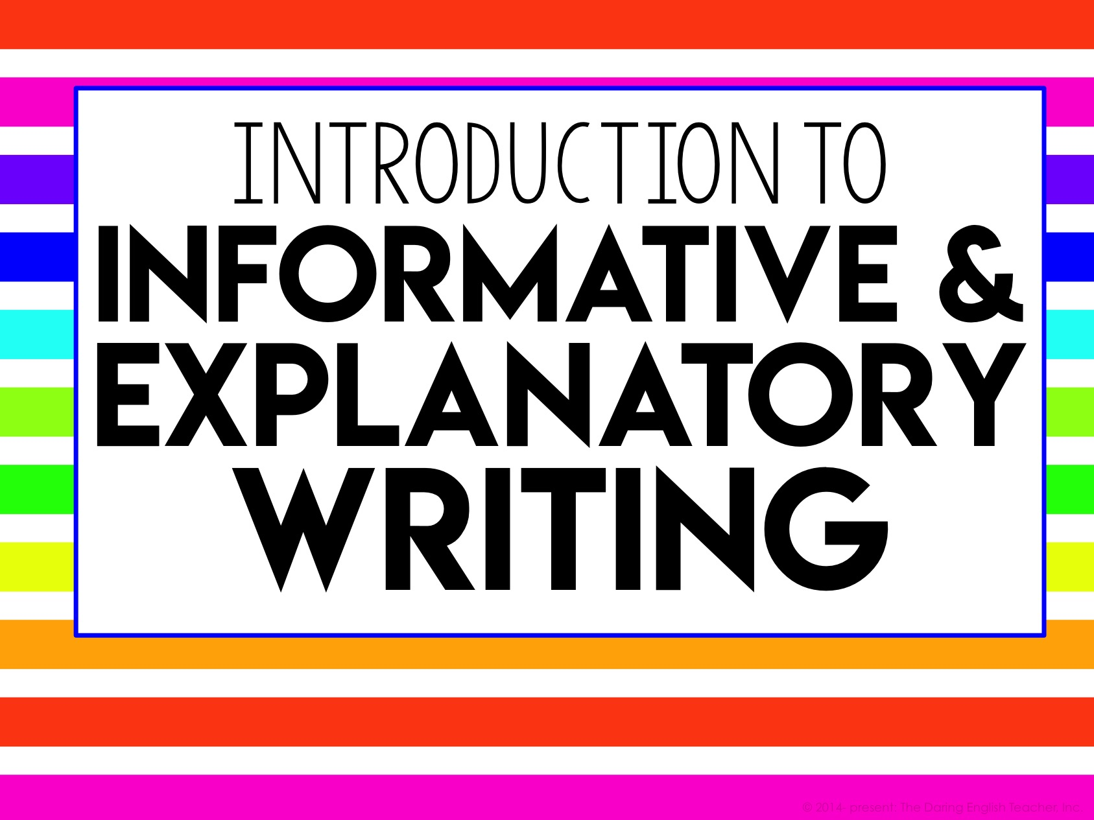
Introduction to
Informative & Explanatory Writing

Slide 2
What is Informative Writing?
Informative writing is nonfiction writing about a topic that provides facts and information to the audience.
This type of writing is straightforward, and it does not contain any opinions.
Informative writing sticks to facts and information.

Slide 3
What is Explanatory Writing?
Explanatory writing is nonfiction writing about a topic that provides information and explanation to the audience.
This type of writing contains explanations and descriptions.
Explanatory writing has a little bit more room for creativity.

Slide 4
Purpose
The purpose of informational writing is to inform the readers about a topic.
The purpose of explanatory writing is to explain a topic to your readers.

Slide 5
Purpose
Through informative and explanatory writing, you can:
Provide new knowledge
Explain a process
Provide an explanation of why
AND MORE!

Slide 6
Informative vs. Argument
Informative Writing
Argument Writing
Includes facts and information
The purpose is to inform the audience
Maintains an objective tone about the topic
Includes facts and information
The purpose is to convince the audience
Maintains a subjective tone about the topic

Slide 7
Informative vs. Narrative
Informative Writing
Narrative Writing
Nonfiction writing
The purpose is to inform the audience
Includes facts and true information
Fiction writing
The purpose is to entertain the audience
Includes made up events, settings, and characters

Slide 8
Where is Informative Writing found?
Informative and explanatory writing can be found many places including textbooks, encyclopedias, newspapers, magazines, websites, instructions, guides, summaries, and reference books.

Slide 9
Writing Informative Essays
Your informative essay will need to…
include a topic.
maintain an objective tone.
have a formal style.
include precise words.
include transitions.
include information about the topic.

Slide 10
Topic
The topic of your essay is what the essay is primarily about.
If you are writing a “How-To” essay about making a peanut butter and jelly sandwich, your topic is about how to make a peanut butter and jelly sandwich.

Slide 11
Objective Tone
Tone: the author’s attitude toward the topic.
Informative and explanatory essays must be written with an objective tone.
You cannot insert any personal opinions, beliefs, or bias into the essay.

Slide 12
Formal Style
To write with a formal style, avoid using slang and contractions.
Also, write in third person (this means no I, you, me, us, or we).

Slide 13
Precise Words
Use precise words related to your topic in your essay. You may need to explain those words.
If you are writing about recycling, you might want to use words like “reduce,” “reuse,” and “renewable.”

Slide 14
Transitions
Writing with appropriate and varied transitions will help clarify information for your audience.

Slide 15
Transitions
Sequence
Examples
First, second, third
First of all, secondly, thirdly
To begin with, next, another
Particularly
For example
In particular
For instance
Specifically

Slide 16
Transitions
To Compare
To Contrast
Similarly
Likewise
In a similar manner
In contrast
On the contrary
However
Although
Nevertheless

Slide 17
Transitions
Cause and Effect
To Conclude
Since
Then
Because
Therefore
Consequently
Thus
In conclusion
In summary
Altogether
All in all

Slide 18
The Writing Process
Follow these steps for your essay
Prewriting
Drafting
Revising
Editing
Publishing

Slide 19
The Writing Process
Follow these steps for your essay
Prewriting
Drafting
Revising
Editing
Publishing
Brainstorm!
Think about your topic.
Research information about your topic if necessary.
Outline your essay.

Slide 20
The Writing Process
Follow these steps for your essay
Prewriting
Drafting
Revising
Editing
Publishing
Review your prewriting and brainstorming.
Write down your ideas.
Create a working draft (a working draft is a draft that is in progress).

Slide 21
The Writing Process
Follow these steps for your essay
Prewriting
Drafting
Revising
Editing
Publishing
Read your draft aloud.
Type your draft into a translate program and have it read back to you.
Participate in peer editing.
Have as many people read your draft as possible.

Slide 22
The Writing Process
Follow these steps for your essay
Prewriting
Drafting
Revising
Editing
Publishing
Review all of your draft’s feedback.
Revise and change your paper as you see fit.
Read your revised draft aloud.

Slide 23
The Writing Process
Follow these steps for your essay
Prewriting
Drafting
Revising
Editing
Publishing
Type your final draft
Submit your essay

Slide 24
Brainstorming
Think about your topic and what you want to explain about your topic.
You may need to do some research to come up with your concrete and supporting details.

Slide 25
Drafting
Using everything from the brainstorming process, begin writing your first draft.
You can always go back and edit and revise your writing.
The key is to get your thoughts and the information onto the paper.

Slide 26
Revising
Once you complete your rough draft, read it aloud.
You can type your rough draft into an Internet translator and have it read to you.
Participate in peer editing.

Slide 27
Editing
Review all of your notes and the peer review notes.
Revise your narrative to improve its quality and content.

Slide 28
Publishing
Prepare the final draft of your informational essay.
Type your essay.
Submit your essay.

